Slide 1
Selection Sort
Scan the array to find its smallest element and swap it with the first element.
Then starting with the second element scan the entire list to find the smallest element and swap it with the second element.
Then starting from the third element the entire list is scanned in order to find the next smallest element.
Example 70, 30, 20, 50, 60, 10, 40
10, 30, 20, 50, 60, 70, 40
10, 20, 30, 50, 60, 70, 40
10, 20, 30, 50, 60, 70, 40
10, 20, 30, 40, 60, 70, 50
10, 20, 30, 40, 50, 70, 60
10, 20, 30, 40, 50, 60, 70

Slide 2
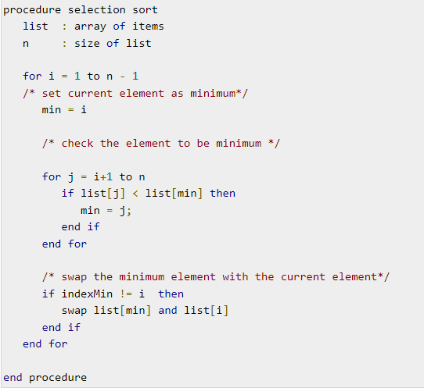
Selection sort algorithm
70, 30, 20, 50, 60, 10, 40
i=70 n-2
Min = i (10)
j= 30 n-1
30 < 70
30 70 20 50 60 10 40
J=70
20 70 30 50 60 10 40
J=30
10 20 70 50 60 30 40
j=20
i=70 min=20 j =20
10 20 70 50 60 30 40

Slide 3
Merge Sort
Divide and conquer approach.
1. divided into smaller sub problems.
These sub problems are solved independently.
If necessary, the solutions of the sub problems are combined to get a solution to the original problem.
The algorithm processes the elements in 3 steps.
If A Contains 0 or 1 elements then it is already sorted, otherwise, Divide A into two sub-array of equal number of elements.
Conquer means sort the two sub-arrays recursively using the merge sort.
Combine the sub-arrays to form a single final sorted array maintaining the ordering of the array.

Slide 4
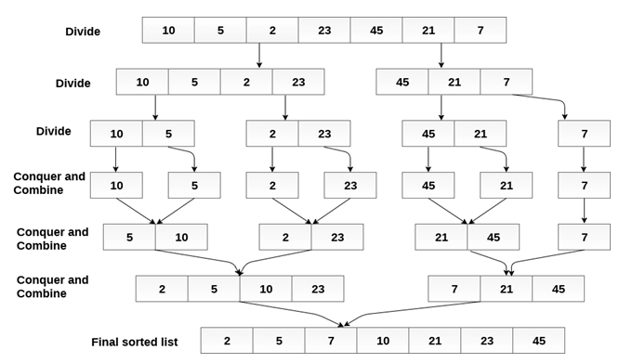

Slide 5
Algorithm
Algorithm mergeSort (A[0..n-1], low, high)
// problem description: sorting the element using merge sort.
// input: array A of unsorted elements , low as beginning pointer of array A and high as end pointer of array A.
// output: sorted array A[0..n-1]
If (low<high) then{
Mid <- low+high/2
mergeSort(A, low, mid)
mergeSort(A, mid+1, high)
Combine(A, low, mid, high)
}

Slide 6
Algorithm Combine(A[0..n-1], low, mid, high)
{
k ← low; // k as index for array temp
i ← low // i as index for left sublist of array A
j ← mid + 1 // j as index for right sublist of array A
While (i <= mid and j <= high) do
{
if (A[i] <= A[j]) then //if smaller element is present in left sublist
{ // copy the smaller element to temp array
temp[k] ← A[i]
i ← i+1
k ← k+1
} else // smaller element is present in right sublist
{// copy that element to temp array
temp[k] ← A[j]
j ← j+1
k ← k+1
}
}
While ( i <= mid ) do // copy remaining elements of left sublist to temp
{
temp[k] ← A[i]
i ← i+1
k ← k+1
}
While ( j <= high) do // copy remaining element of right sublist to temp
{
temp[k] ← A[j]
j ← j+1
k ← k+1
}
}

Slide 7
Quick Sort
Uses the divide and conquer strategy.
Division is dynamically carried out.
Divide – split the array into two sub arrays that each element in the left sub array is less than or equal the middle element and each element in the right sub array is greater than the middle element. The splitting of the array into two sub arrays is based on pivot element. All the elements that are less than pivot should be in left sub array and all the element that are more than pivot should be in right sub array.
Conquer – recursively sort the two sub arrays.
Combine – combine all the sorted elements in a group to form a list of sorted elements.

Slide 8
50, 30, 10, 70, 80, 20, 40, 90.
Low High
10, 20, 30, 40, 50, 70, 80, 90.
Pivot j i
pivot j i A[i] <=pivot; i++ ; until element pointed by
i is greater than A[Low]
A[j] > pivot; j-- ; until the element pointed
by j is less than A[Low]
we cannot decrement further;
i<j; A[i] and A[j] swap;
j<i; A[low] and A[j] swap;
Low
10, 20, 30, 40
j I
70, 80, 90
j pivot i
50 30 10 70 80 20 40 90
Pivot =50 low=50 high=90
i=0 j=7
20 30 10 40 50 80 70 90
j i
20 30 10 40
Pivot=20 low = 20 high=40
i=0 j= mid-1
10 20 30 40
j i
10 20 30 40
10 20 30 40 50 70 80 90

Slide 9
Quick_sort(int A[], int low, int high){
If (low < high){
Key_pos = partition(A, low , high)
}
Quick_sort(A, low, key_pos-1)
Quick_sort(A, key+1, high)
}
Partition(int A[], int low, int high){
Int i , j , key, temp, flag;
Key = A[low]
i=low
J=high
Flag = 1
While(flag){
While(key>A[i] && (i<high)){
I = i+1
}
While(key<A[j]){
J=j-1
}
If(i<j){
Temp=A[i]
A[i]=A[j]
A[j]=temp
}else
Flag=0} end of outermost while
Temp = A[low]
A[low] = A[j]
A[j] = temp
Return (j)
}

Slide 10
Insertion Sort
Decrease and Conquer
Number of sub problems need to be solved.
Several sub problems that need to be solved.
One sub problem that needs to be solved.
Approaches:
Change an instance into one smaller instance of the problem.
Solve the smaller instance.
Convert the solution of the smaller instance into a solution for the larger instance.
Top down(recursive)
Bottom up (iterative and non recursive)

Slide 11
Insertion Sorting Algorithm
30, 10, 50, 20, 60, 40
30 10 50 20 60 40
10 30 50 20 60 40
10 30 50 20 60 40
10 20 30 50 60 40
10 20 30 50 60 40
10 20 30 40 50 60
Algorithm inser_sor(A[0..n-1])
//problem description: sorting the element using insertion sort
//input: an array of n element.
//output: sorted array in ascending order
for i ← 1 to n-1 do
{
temp ← A[i] // mark A[i]th element
j ← i-1
While (j >=0) AND (temp < A[j]) do
{ // comparing all the previous elements of A[i] with A[i]. If any greater element is found then insert it at proper position
A[j+1] ← A[j]
j ← j-1
}
A[j+1] ← temp // copy A[i] element at A[j+1}
}

Slide 12
Radix sort
Which is based on the values of individual digits of numbers to be sorted.
3 digit decimal number, 673.
The most significant digit of this number (i.e 6) hundred position, next 7 is in tens and next number 3 least significant digit.
673 573 02 21 33 42 21 02 33 42 02 21 33 42
36 72 43 21 47 12 67 55 21 72 12 43 55 36 47 67 12 21 36 43 47 55 67 72
 | 0 | 1 | 2 | 3 | 4 | 5 | 6 | 7
0 |  |  | 21
1 |  |  |  |  |  |  |  | 72
2 |  | 12
3 |  |  |  |  | 43
4 |  |  |  |  |  | 55
5 |  |  |  | 36
6 |  |  |  |  | 47
7 |  |  |  |  |  |  | 67
 | Front | rear
0 | 02 | 22
1
2 | 21
3 | 33
4 | 42

Slide 13
Struct node{
Int num;
Int link;
}
Struct Lnode[max]
Radix_sort(int a[], int maxsixe){
Int I,j,k,key,pos, qpos, start, dig, dg, pval;
Int front[10], rear[10]
Initialize the list
For(j=0;j<maxsize-1;j++){
Lnode[j].num = a[j];
Lnode[j].link=j+1}
Lnode[maxsize-1].num = a[maxsize-1]
Lnode[maxsize-1].link=-1
Start=0; // head of the list
For(dig=1;dig<4;dig++){
For(k=0;k<10;k++){
Front[k]=-1 //initialization of queue
Rear[k]=-1}
While(start!=-1){
Pos=start
Start=Lnode[start].link
Ky=Lnode[pos].num;
Pval=pow(10,dig-1);
Dg=(key/pval)%10
Qpos=rear[dg]
If(qpos == -1)
Front[dg]=pos
Else
Lnode[qpos].link = pos;
Rear[dg] = pos}
// combining the elements into a single list
For(i=0;i<10 && front[i]==-1;i++){
}
Start=front[i]
While(i<=9){ link the remaining queues
For(j=i+1;j<10 && front[j]==-1;j++){
}
If(j<=9){
Pos=j}
Lnode[rear]].link=front[j]
i=j
}
Lnode[rear[pos]].link=-1;}
// copying into the original table
For(j=0;j<maxsize;j++){
A[j]=lnode[start.num;
Start =lnode[start].link;
}}

